Slide 1

if

Slide 2
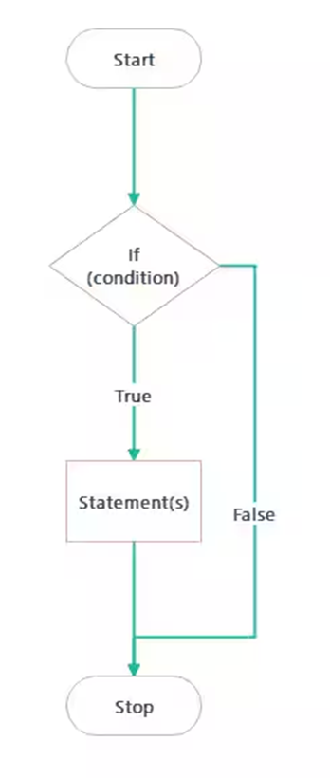
if - Syntax
if (condition) {
\\statements if condition is true
}
Example - Positive or negative
int num = 10;
if (num > 0) {
printf("Number is positive\n");
}

Slide 3
Even or Odd
Start
Declare a variable num
#include <stdio.h>
int main() {
int num;
printf("Enter a number: ");
scanf("%d", &num);
if (num % 2 == 0)
printf("%d is Even\n", num);
else
printf("%d is Odd\n", num);
return 0;
}
Scan value for num
If divisible by 2
No
Yes
Print num is Even
Print num is Odd
End

Slide 4
Calculator using ifs
#include <stdio.h>
int main() {
char op;
double a, b;
printf("Enter first number: ");
scanf("%lf", &a);
printf("Enter operator (+, -, *, /): ");
scanf(" %c", &op); // space before %c to ignore newline
printf("Enter second number: ");
scanf("%lf", &b);
// Using only if statements
if (op == '+') {
printf("Result = %.2lf\n", a + b);
}
if (op == '-') {
printf("Result = %.2lf\n", a - b);
}
if (op == '*') {
printf("Result = %.2lf\n", a * b);
}
if (op == '/') {
if (b != 0)
printf("Result = %.2lf\n", a / b);
else
printf("Error! Division by zero not allowed.\n");
}
return 0;
}

Slide 5
if() else
if (condition) {
// statements if condition is true
} else {
// statements if condition is false
}

Slide 6
if else - Example
int num = 0;
if (num > 0) {
printf("Positive\n");
} else if (num < 0) {
printf("Negative\n");
} else {
printf("Zero\n");
}

Slide 7
if() else and if() else if() else
if() else
if() else if() else
int num = -5;
if (num >= 0) {
printf("Number is non-negative\n");
} else {
printf("Number is negative\n");
}
if (condition1) {
// if condition1 is true
} else if (condition2) {
// if condition2 is true
} else {
// if none of the above is true
}

Slide 8
Nested if - syntax
if (condition1) {
if (condition2) {
// statements if both are true
}
}
Example - Positive or negative
int a = 10, b = 20;
if (a > 0) {
if (b > 0) {
printf("Both a and b are positive\n");
}
}

Slide 9
Nested if - Examples
int a = 5, b = 3;
if (a > 0 && b > 0) {
printf("Both are positive\n");
}
if (a > 0 || b < 0) {
printf("At least one condition is true\n");
}
if (!(a < b)) {
printf("a is NOT less than b\n");
}
int age = 20;
if (age >= 18 && age <= 60) {
printf("You are an adult.\n");
} else if (age > 60 || age < 0) {
printf("Invalid age or senior citizen.\n");
} else {
printf("You are a minor.\n");
}

Slide 10
Grading with if
#include <stdio.h>
int main() {
int marks;
printf("Enter your marks (0-100): ");
scanf("%d", &marks);
if (marks >= 90) {
printf("Grade: A\n");
}
if (marks >= 80 && marks < 90) {
printf("Grade: B\n");
}
if (marks >= 70 && marks < 80) {
printf("Grade: C\n");
}
if (marks >= 60 && marks < 70) {
printf("Grade: D\n");
}
if (marks < 60) {
printf("Grade: F\n");
}
return 0;
}

Slide 11
Grading with if else
#include <stdio.h>
int main() {
int marks;
printf("Enter your marks (0-100): ");
scanf("%d", &marks);
if (marks >= 90) {
printf("Grade: A\n");
} else if (marks >= 80) {
printf("Grade: B\n");
} else if (marks >= 70) {
printf("Grade: C\n");
} else if (marks >= 60) {
printf("Grade: D\n");
} else {
printf("Grade: F\n");
}
return 0;
}

Slide 12
If alphabet or number
#include <stdio.h> int main() { char ch; printf(“Enter a character: “); scanf(“%c”, &ch); if ((ch >= ‘A’ && ch <= ‘Z’) || (ch >= ‘a’ && ch <= ‘z’)) { printf(“It is an Alphabet.\n”); } else if (ch >= ‘0’ && ch <= ‘9’) { printf(“It is a Number.\n”); }
else { printf(“It is neither Alphabet nor Number.\n”); } return 0; }

Slide 13
Assignment
Write a C program that checks whether a given year is a leap year or not using if statements
Requirements:
Ask the user to enter a year
Apply the leap year rules:
A year is a leap year if it is divisible by 400, OR
It is divisible by 4 but not divisible by 100
Use if (or if-else) to decide.
Display the result:
"Leap Year" if true
"Not a Leap Year" otherwise

Slide 14
Switch - case

Slide 15
Switch-case General Syntax
switch (expression) {
case constant1:
// statements
break;
case constant2:
// statements
break;
case 'character1':
// statements
break;
case 'character2':
// statements
break;
default:
// statements (if no case matches)
}
1. switch (expression)
The expression must evaluate to an integer or character type.
Example: switch (x) or switch (marks / 10).
2. case constant:
Each case compares the expression with a constant value.
If it matches, the code inside runs.
3. break;
Stops execution of the switch.
Without break, execution will “fall through” to the next case.
4. default:
Optional. Runs if no case matches.
Like the else in an if-else statement.

Slide 16
Grading with Switch-case
#include <stdio.h>
int main() {
int marks;
printf("Enter your marks (0-100): ");
scanf("%d", &marks);
// Divide marks by 10 to group into ranges
switch (marks / 10) {
case 10: // for 100
case 9: // 90–99
printf("Grade: A\n");
break;
case 8: // 80–89
printf("Grade: B\n");
break;
case 7: // 70–79
printf("Grade: C\n");
break;
case 6: // 60–69
printf("Grade: D\n");
break;
default: // below 60
printf("Grade: F\n");
}
return 0;
}

Slide 17
Day of week (1-7)
#include <stdio.h>
int main() {
int day;
printf("Enter day number (1-7): ");
scanf("%d", &day);
switch(day) {
case 1: printf("Monday\n"); break;
case 2: printf("Tuesday\n"); break;
case 3: printf("Wednesday\n"); break;
case 4: printf("Thursday\n"); break;
case 5: printf("Friday\n"); break;
case 6: printf("Saturday\n"); break;
case 7: printf("Sunday\n"); break;
default: printf("Invalid day number\n");
}
return 0;
}

Slide 18
Check vowel/consonants using switch
#include <stdio.h>
int main() {
char ch;
printf("Enter an alphabet: ");
scanf("%c", &ch);
switch (ch) {
case 'a':
case 'e':
case 'i':
case 'o':
case 'u':
case 'A':
Case ‘E’: case ‘I’: case ‘O’: case ‘U’:
printf(“It is a Vowel.\n”);
break;
default: // Check if it is an alphabet
if ((ch >= ‘A’ && ch <= ‘Z’) || (ch >= ‘a’ && ch <= ‘z’))
printf(“It is a Consonant.\n”);
else
printf(“It is not an Alphabet.\n”);
}
return 0;}

Slide 19
if-else Vs. switch-case
if-else
switch-case
int marks = 85;
if (marks >= 90) printf("A");
else if (marks >= 80) printf("B");
else if (marks >= 70) printf("C");
else printf("F");
int choice = 2;
switch(choice) {
case 1: printf("Option 1"); break;
case 2: printf("Option 2"); break;
case 3: printf("Option 3"); break;
default: printf("Invalid choice");
}

Slide 20
if-else Vs. switch-case
Use if-else when:
Use switch-case when:
Need to check ranges (like marks between 80 and 90)
Need complex conditions (e.g., age > 18 && salary > 50000)
Decisions are not based on a single discrete value
Checking a single variable against multiple constant values
The conditions are like a menu selection or fixed categories
Example: days of week, menu options, grades with integer divisions

Slide 21
Assignment
Write a C program that simulates a traffic light using switch-case
Requirements:
Display the options:
R or r → Red Light
Y or y → Yellow Light
G or g → Green Light
Ask the user to enter a character representing the light
Use switch-case to print the meaning:
Red → “STOP”
Yellow → “READY”
Green → “GO”
Handle both uppercase and lowercase inputs
For any other character, print “Invalid signal.”

